Slide 1
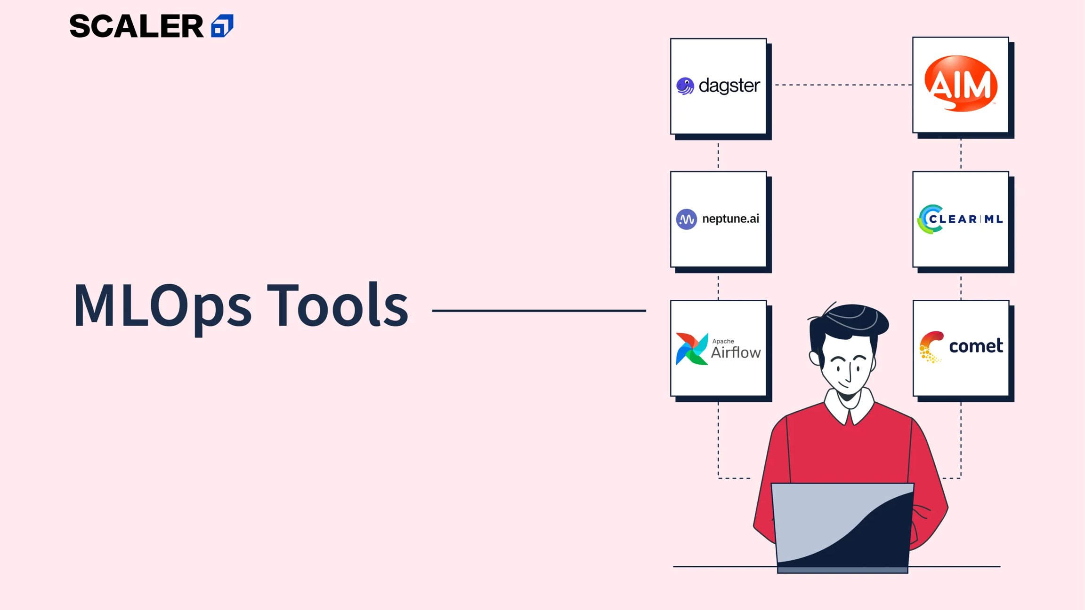
SriRam’s

Slide 2
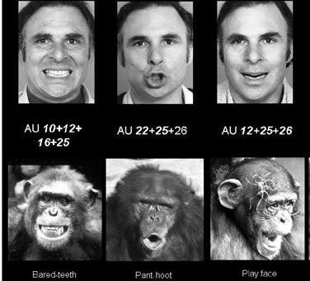
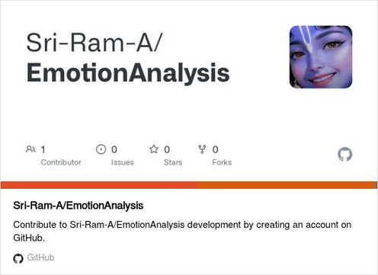
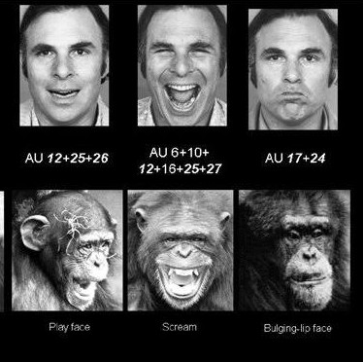
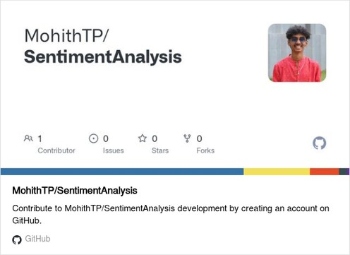
What is Sentiment Analysis ?
What is Sentiment Analysis?
Sentiment Analysis is a Natural Language Processing (NLP) technique used to identify and classify human emotions expressed in text data.
It goes beyond simple sentiment (positive/negative) and detects specific emotions such as:
Joy Sadness Anger Fear Neutral
Department of AI and ML

Slide 3
Machine Learning Operations (MLOps)
Team No :11
SENTIMENT ANALYSIS
SriRam A | Srujan | Sumith | TP Mohith

Slide 4

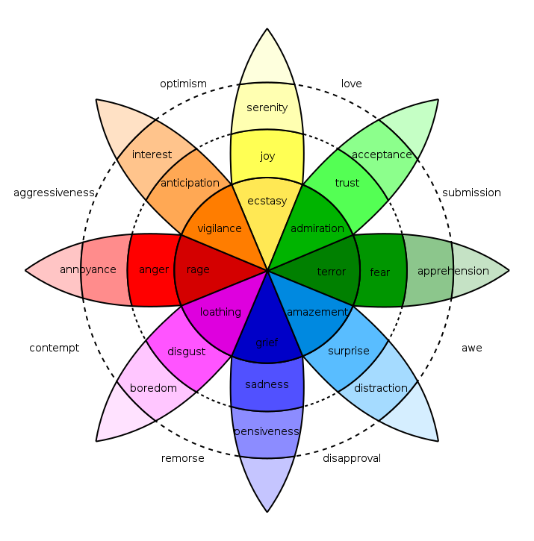
Motivation – Real-World Example (Social Media & Chatbots)
Go, change the world
Every day, millions of users express emotions through:
Social media posts Customer reviews Chat messages
Manual emotion understanding is:
Time-consuming Not scalable Subjective
Department of AI and ML

Slide 5
PROBLEM STATEMENT
Go, change the world
Large amounts of text from social media, customer feedback, and online communication contain important emotional insights.
Manually identifcation from this unstructured data is slow, subjective, and not scalable.
This project develops an automated emotion analysis system using machine learning and natural language processing to accurately classify emotions from text, while applying MLOps practices to deploy, manage, and monitor the model efficiently.
OBJECTIVES
To collect and preprocess text-data for classification using NLP techniques.
To build and evaluate machine learning and deep learning models for emotion detection.
To optimize model performance using hyperparameter tuning techniques.
To deploy the trained emotion analysis model as a scalable web service.
To implement MLOps practices for automation, version control, monitoring, and reproducibility.
Department of AI and ML

Slide 6
DATASET DESCRIPTION
Go, change the world
We train on three complementary datasets.
The Kaggle Twitter Sentiment dataset (1.6M tweets, 2009) provides scale and realistic social media language; we use the text & map binary sentiment to our 7 emotion classes.
(https://www.kaggle.com/datasets/jp797498e/twitter-entity-sentiment-analysis)
GoEmotions adds 58K Reddit comments with high-quality human emotion labels, which we convert to our schema using the authors’ official mapping.
(https://github.com/google-research/google-research/tree/master/goemotions)
ISEAR contributes longer, self-reported emotional unambiguous examples of each emotion.
(https://www.kaggle.com/datasets/faisalsanto007/isear-dataset)
narratives, offering clear,
Department of AI and ML

Slide 7

Go, change the world

Slide 8
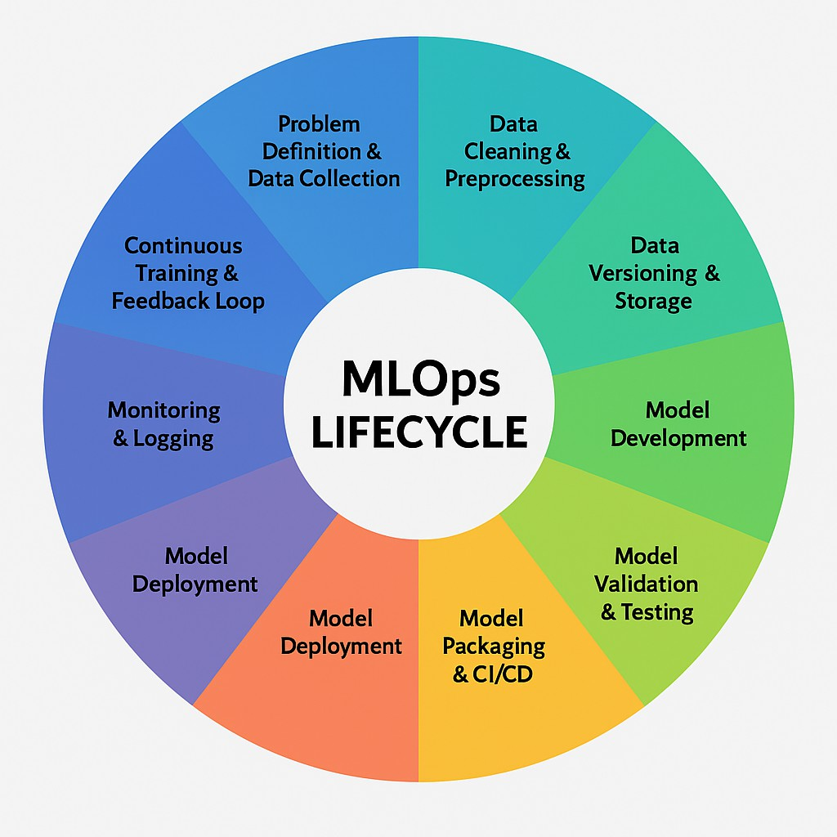
Pandas Profiler
Mother of MLOPS
Github Action VS Code Tasks
NLTK and submodules
DVC, Github Google Drive DVC Pipeline
Tensorflow. keras-tuner, RayOptuna MLFlow
Evidently AI Grafana
Prometheus
MLFlow registry (Challenger & Champion)
Docker/Podman Tensorflow Serving
AWS Sagemaker Render

Slide 9
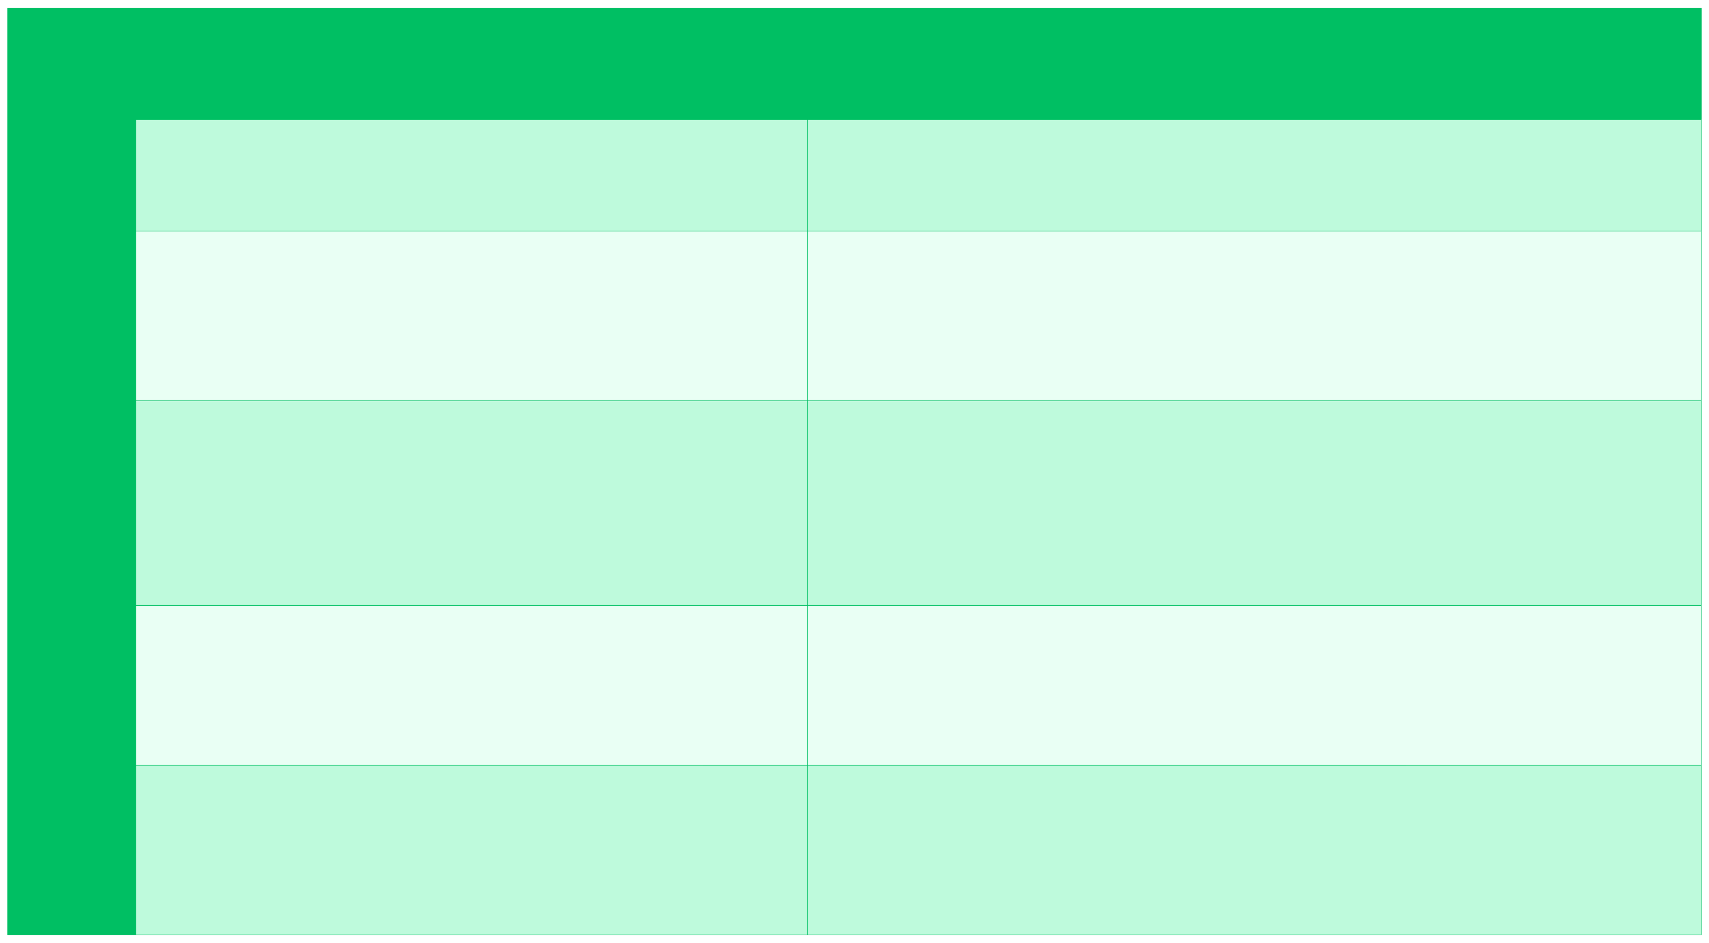
TOOLS USED
Go, change the world
Component
MLOPs Tools
DVC, Github, Pandas Profiler
1
Data Management
Experiment Tracking and Version Control
Automation and Pipeline Orchestration
MLflow
2
3
DVC Pipelines
Model Deployment & Serving
Monitoring & Governance and collaboration
Docker,AWS SageMaker,Render,TensorflowServing
4
5
Evidently AI,Grafana, GitHub Actions
Department of AI and ML

Slide 10
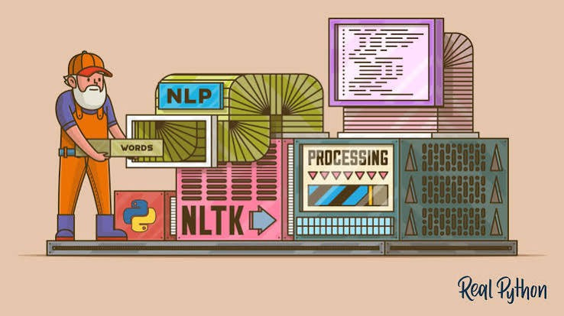
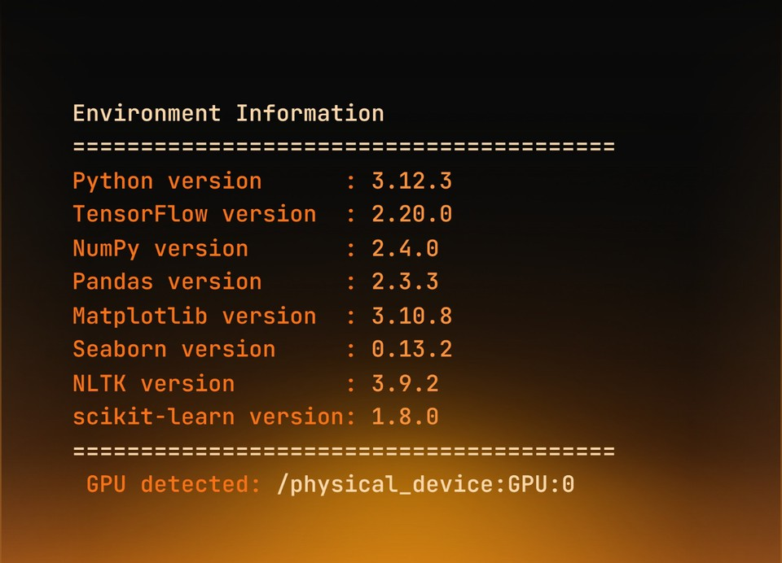
NLTK – Text Preprocessing
Stage1 - Data Cleaning and Processing
Always mention your packages and their versions.
Experiment with notebooks
instead of .py
Use Pathlib and Ruff
NLTK
performs
tokenization,
stopword
removal, and lemmatization for cleaner emotion analysis input data

Slide 11
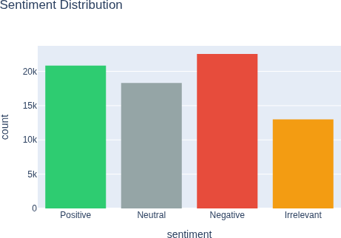
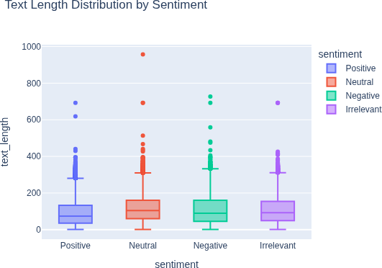
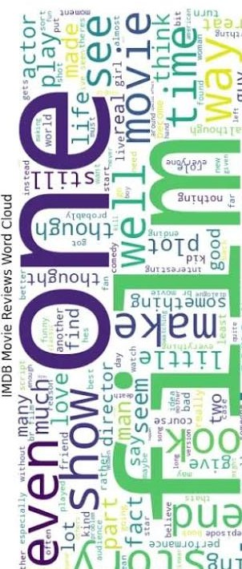
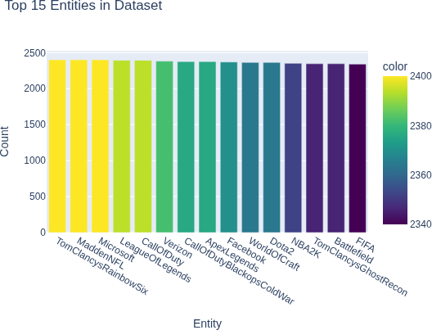
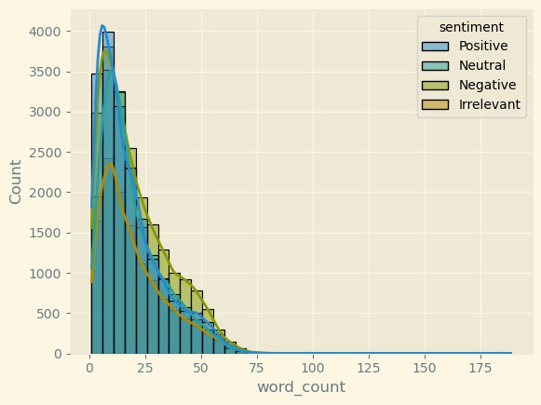
Stage1 - Data Cleaning and Processing

Slide 12






Stage1 - Data Cleaning and Processing
Pandas Profiler
NLTK/Spacy
Standard DL Libraries
Papermill (in case of python Notebooks)
Vanilla Pandas
Scikit-learn

Slide 13
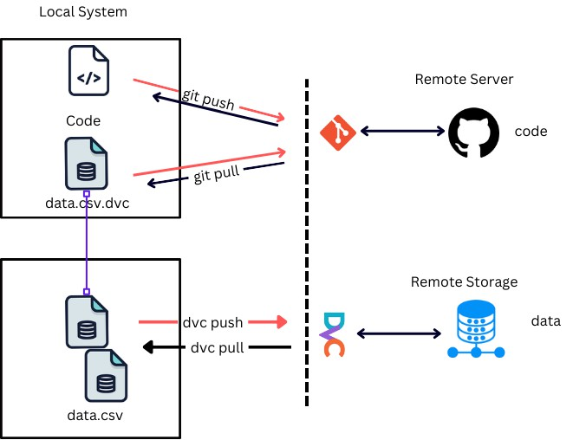
DVC – Data & Model Versioning
Stage2 - Data Versioning and Storage
Go, change the world
What is it ?
DVC tracks and trained
How it helps ?
datasets
machine
When the emotion
learning models.
dataset or LSTM model
is updated, ensures the
dataset and
DVC
correct
Why to use ?
Machine learning depends on both code and data.
model
versions are linked and reproducible.
Department of AI and ML

Slide 14
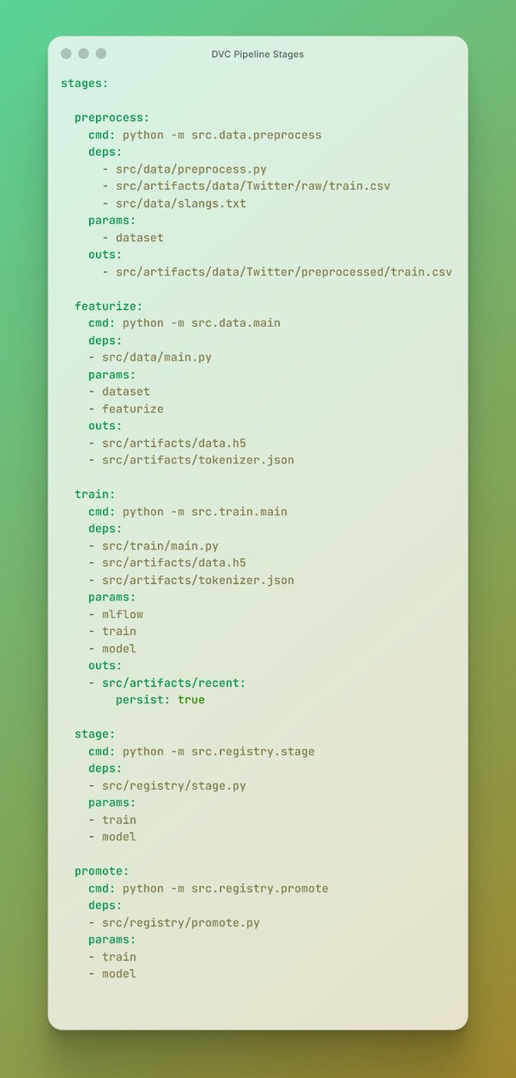
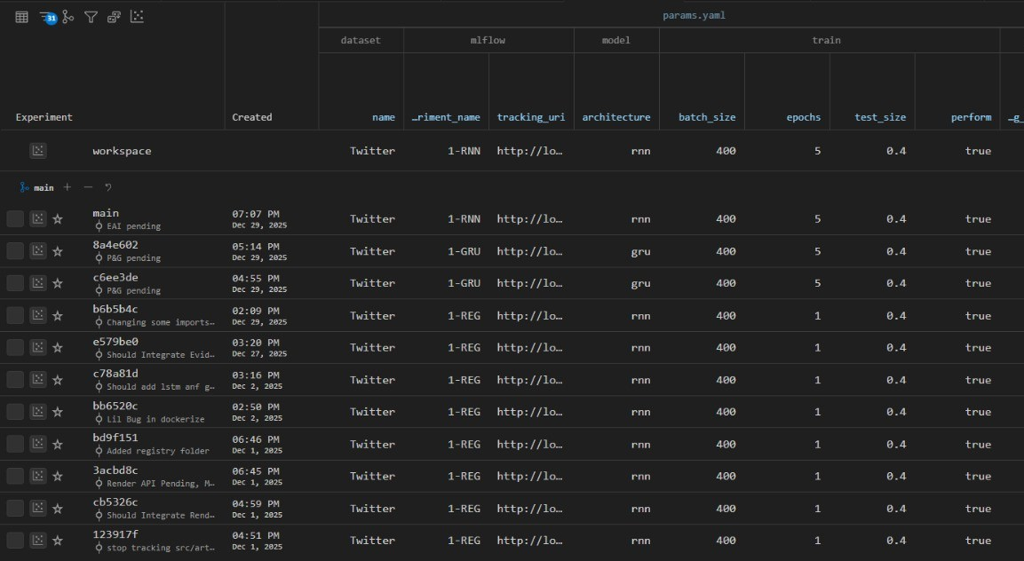
DVC – Data & Model Versioning
Stage2 - Data Versioning and Storage
DVC – Pipelines
Department of AI and ML

Slide 15

Stage 2 - Data Versioning and Storage
Remember Versioning Data is NOT same as storing data !!!
lakeFS – An open-source management platform that transforms object storage (like AWS S3, Google Cloud Storage, or Azure Blob) into a Git-like repository.
Pachyderm – A containerized, data-centric platform built on Docker and Kubernetes.
Dolt – A relational SQL database that you can clone, fork, branch, merge, push, and pull exactly like a Git repository. It versions tables rather than raw files.
Delta Lake / Apache Iceberg – Open-source storage frameworks that bring ACID transactions and time-travel version control to Spark, Presto, and large tabular data formats.
Git LFS (Large File System) – A standard Git extension that replaces large assets (like datasets or model weights) with text pointers inside Git, while storing the actual file on a remote server.

Slide 16
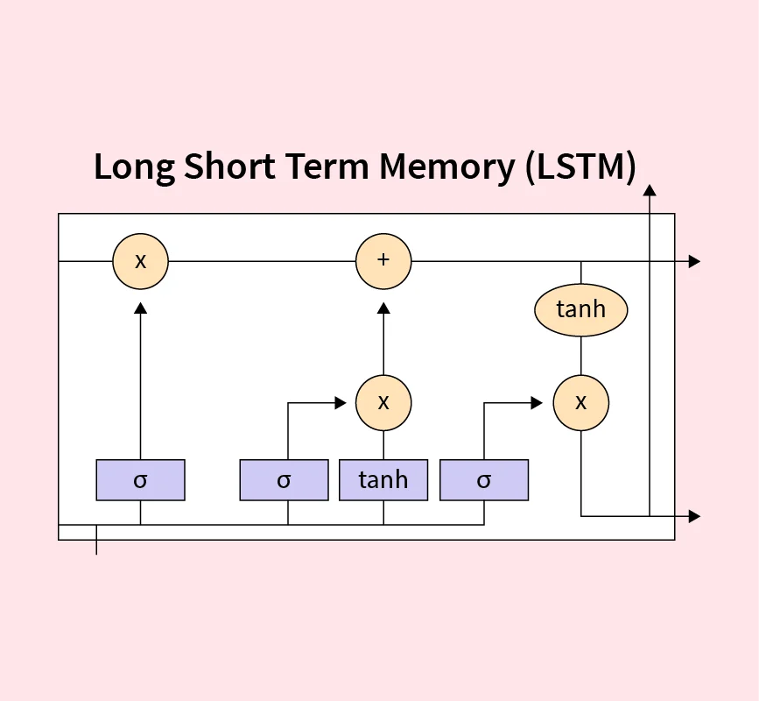
LSTM – Emotion Classification Model
Go, change the world
Stage 3.1 - Model Development
Why use it?
Text data is sequential, and the meaning of a word depends on the surrounding words.
Traditional ML models cannot capture this context effectively.
How it helps ? LSTM captures word order and contextual information in text,
enabling accurate emotion classification by understanding the emotional flow of sentences.
Department of AI and ML

Slide 17
Stage 3.1 in Model Development primarily deals with finding the best model architecture and parameters - Hyperparamter Tuning
Tensorboard
keras-tuner
RayOptuna
Pytorch Lightning

Slide 18
MLFLOW
Stage 3.2 - Model^{G}D^{o, c}e^{h}v^{an}e^{g}l^{e}o^{t}p^{he}m^{wo}e^{r}n^{ld}t
What is MLflow?
MLflow is an open-source MLOps platform used to manage the complete machine learning lifecycle, including experimentation, tracking, and model management.
Why is MLflow used?
It is used to track hyperparameters, performance metrics, and model artifacts, enabling reproducibility and systematic comparison of multiple experiments.
How it helps ?
Our model involves multiple CNN configurations and training runs. MLflow ensures organized experiment tracking, version control, and reliable selection of the best-performing model, while supporting future deployment.
Department of AI and ML

Slide 19
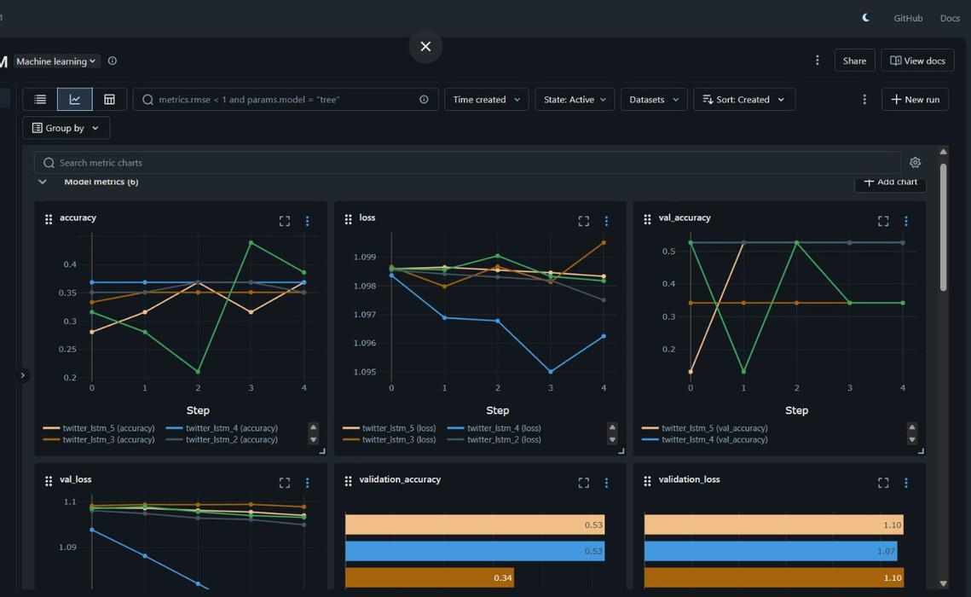
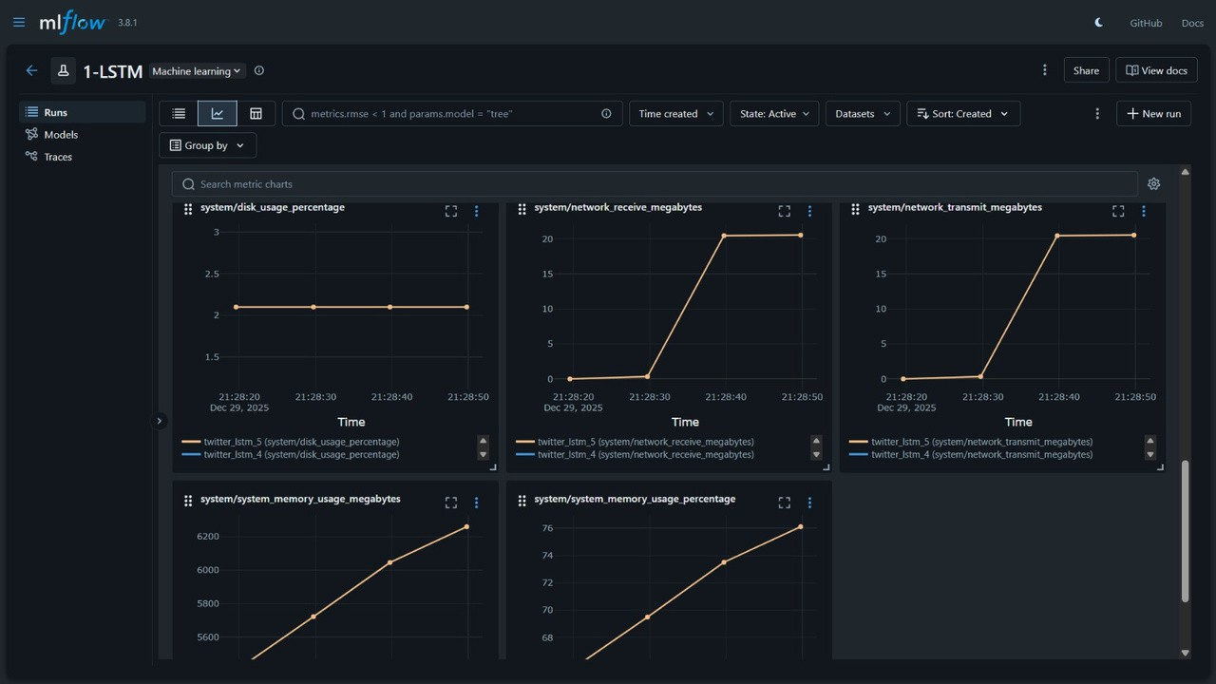
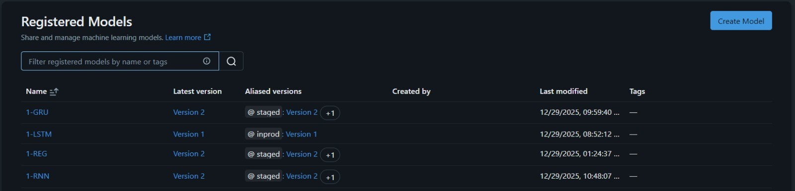
Stage 3.2 - Model Development

Slide 20
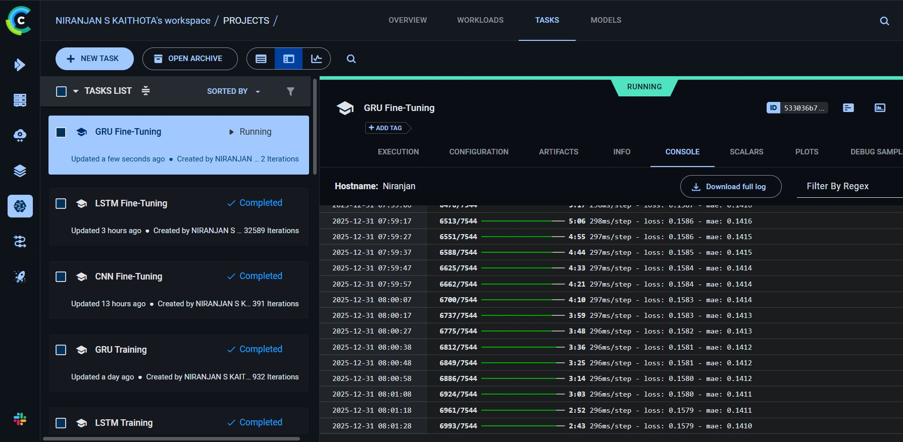
Stage 3.2 - Model Development
MLFlow
Databrics
ClearML
CometML
Weights and Biases
Prefect
Apache Airflow
Stage 3.2 of Model Development fundamentally deals with storing your runs and experiments which can be later reproduced

Slide 21
Stage 4 - Model testing and evaluation
MLFlow registry (Challenger & Champion)
PyTest
Deepchecks
Evidently
Scikit-learn
Crucial Aspect is Model Evaluation and Testing can be based on multiple parameters
Based on Power Consumption and Emission
Based on How well you can Explain your model
Based on ethical working of the model
Based on DevOps params
Based on Metrics of production vs staged model
Based on Multiple customer facing models
SHAP and LIME
GradCAM++
Task Manager
EcoLogits
CodeCarbon

Slide 22

Stage 5 - Model packaging
Go, change the world
Department of AI and ML

Slide 23
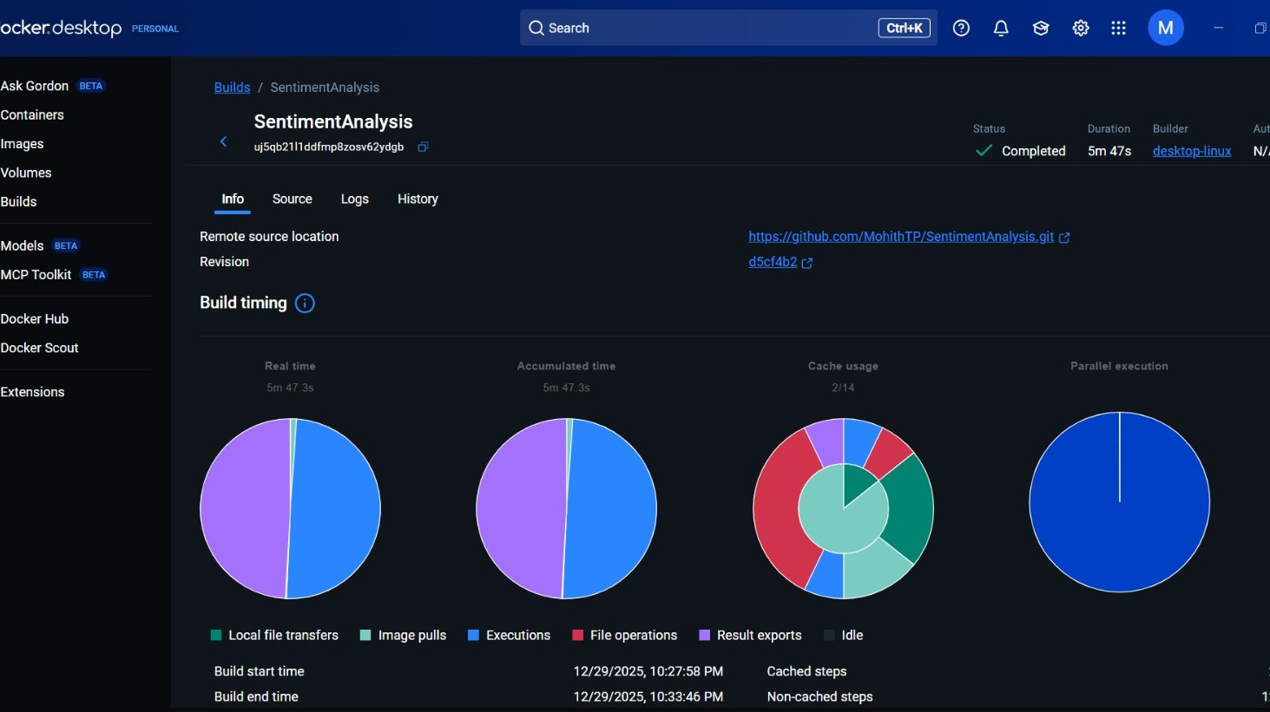
Stage 5 - Model packaging

Slide 24
Render – Cloud Deployment and Model Hosting
Stage 5 - Model D^{Go}e, p^{ch}lªo^{n}y^{ge}m^{th}e^{e} n^{wo}t^{rld}
What is it ?
Render is a cloud platform used to deploy machine learning applications.
Why use it?
Motion analysis models must be accessible as a live service.
How it helps ?
Render deploys the emotion analysis model as an API, allowing real-time emotion prediction without running the model locally.
Department of AI and ML

Slide 25
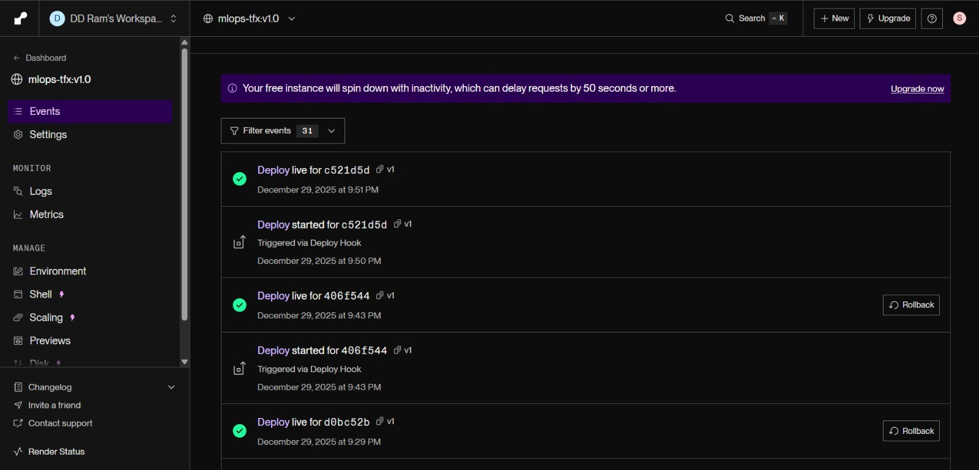
Stage 5 - Model Deployment
Department of AI and ML

Slide 26
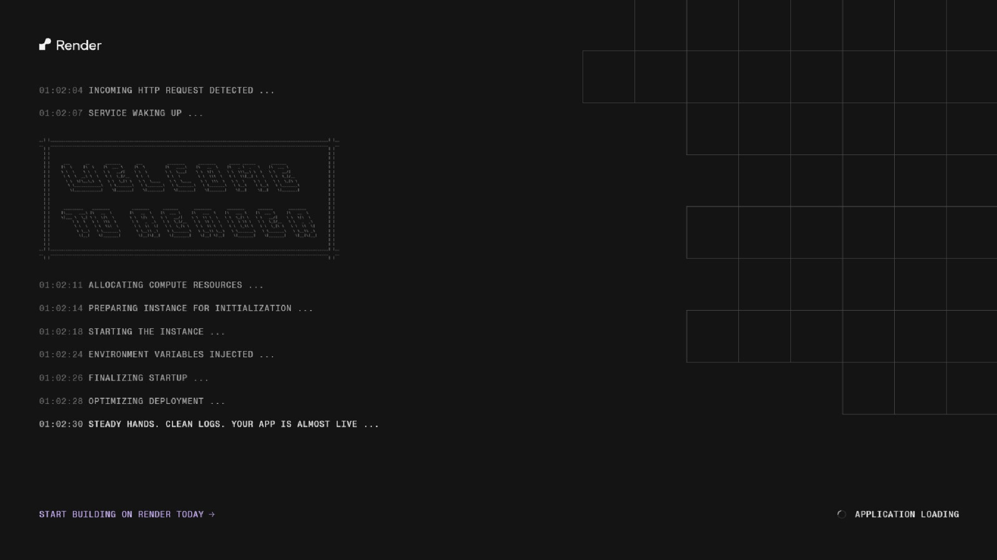
Stage 5 - Model Deployment

Slide 27
AWS – Cloud Deployment and Model Hosting
Stage 5 - Model^{Go}D^{, c}e^{h}p^{an}l^{g}o^{e}y^{th}m^{e w}eºn^{rl}t^{d}
Elastic Container Registry (ECR):
Purpose: Serving as the private repository for our versioned Docker images. Workflow: Automated CI/CD (GitHub Actions) builds the environment and pushes the containerized Bi-LSTM model to ECR.
SageMaker Real-Time Hosting:
Endpoint: A fully-managed HTTPS endpoint that serves predictions in milliseconds. Compute: Hosted on an ml.m5.large instance, providing the optimized CPU resources needed for TensorFlow inference.
Life-cycle: Automated deployment using the SageMaker Python SDK to create model
configurations and production variants.
Department of AI and ML

Slide 28
AWS – Cloud Deployment and Model Hosting
Stage 5 - Model Deployment
Identity & Access Management (IAM):
Security: Utilizing SageMaker Execution Roles to grant "Least Privilege" access to cloud resources.
Authentication: Local Proxy signs requests using AWS Signature Version 4 (SigV4)
to ensure only authorized clients can access the model.
Hybrid Cloud Architecture:
The model "lives" in the cloud, but the Local Proxy acts as a secure bridge, allowing the Chrome Extension to perform complex sentiment analysis without exposing sensitive AWS credentials.
Department of AI and ML

Slide 29
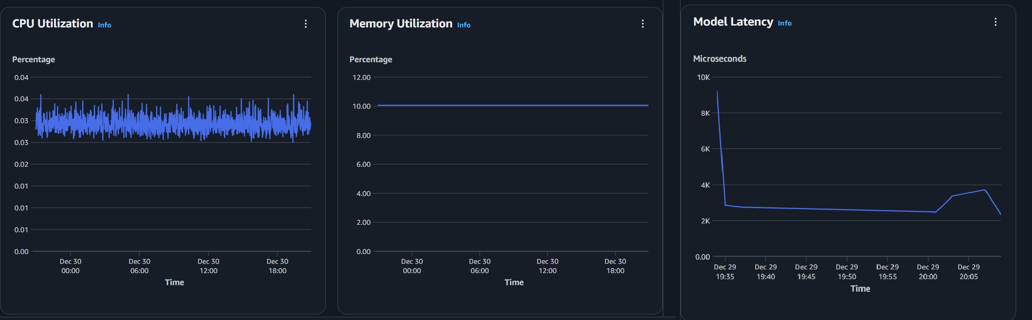
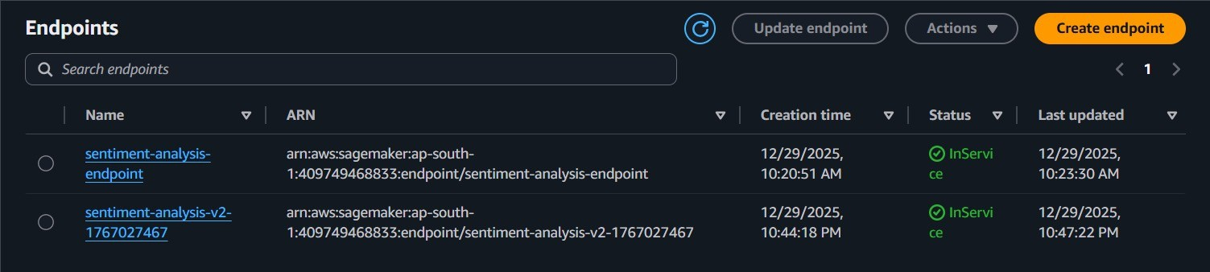
Stage 5 - Model Deployment

Slide 30

Stage 5 - Model Deployment
AWS Sagemaker
Render
Heroku
Digital Ocean
Github Pages
Cloudflare Pages
Vercel
E2E Networks
Microsoft Azure
Modal
Hugging face Inference

Slide 31
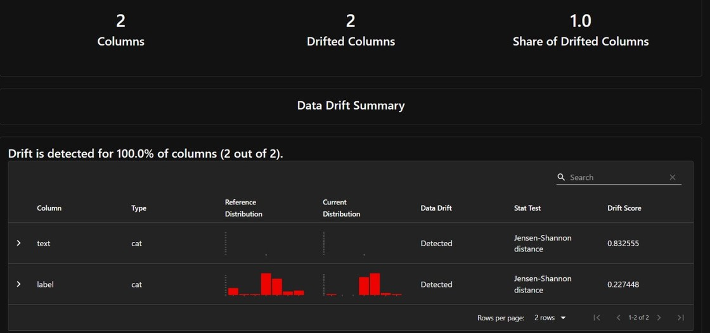
Evidently AI – Data Drift Detection
_{Stage 6} G₋o,_{M}cha_{o}n_{n}ge_{it}th_{o}e_{r}w_{in}or_{g}ld
What is it ?
Evidently AI detects changes in data distribution over time.
Why use it?
Language and emotional expressions evolve.
How it helps ?
Detects data drift in incoming text Alerts when retraining is required Maintains model accuracy over time
Department of AI and ML

Slide 32
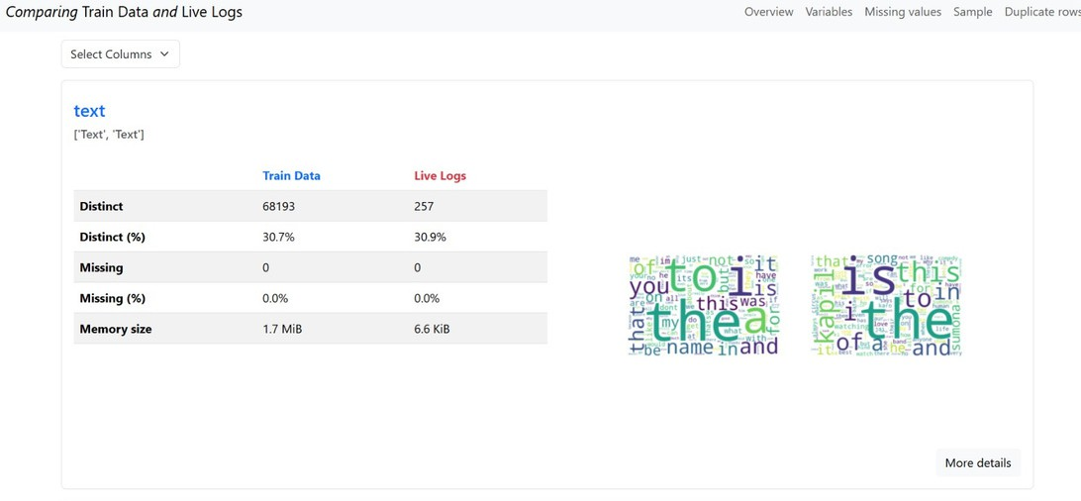
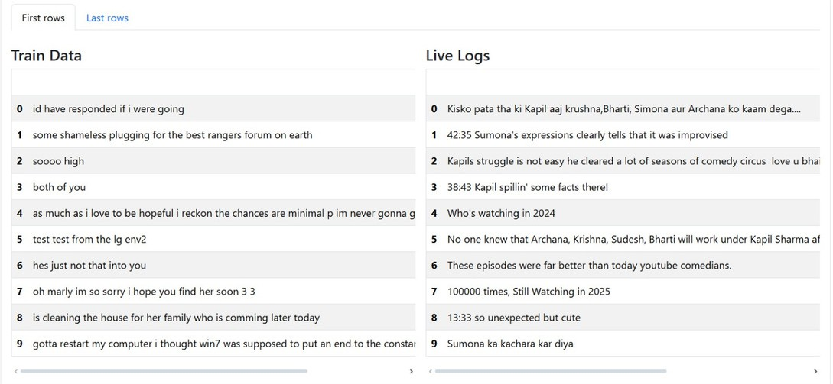
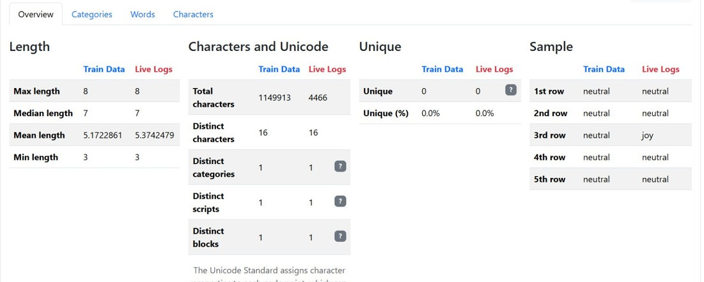
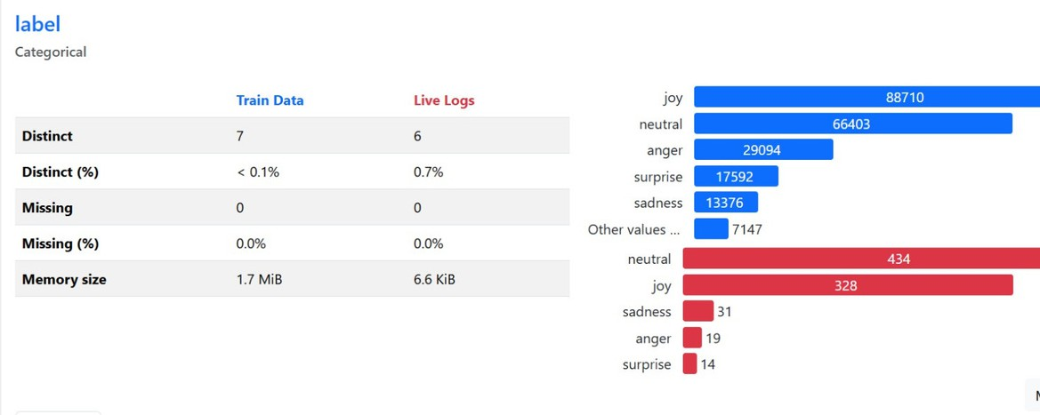
Evidently AI – Data Drift Detecti^{S}o^{ta}n^{ge 6 - Monitoring}
Go, change the world
Department of AI and ML

Slide 33
Grafana & Prometheus – System & Performance Monitoring
_{Stage 6}G₋o, _{M}cha_{o}n_{n}ge_{i}t_{t}h_{o}e _{r}w_{i}o_{n}rl_{g}d
What is it ?
Grafana is an open-source monitoring and visualization tool used to track system and application performance metrics in real time.
Why use it?
To monitor the performance of the deployed emotion analysis model.
How it helps ?
Monitors CPU and memory usage
Tracks system performance during predictions
Department of AI and ML

Slide 34
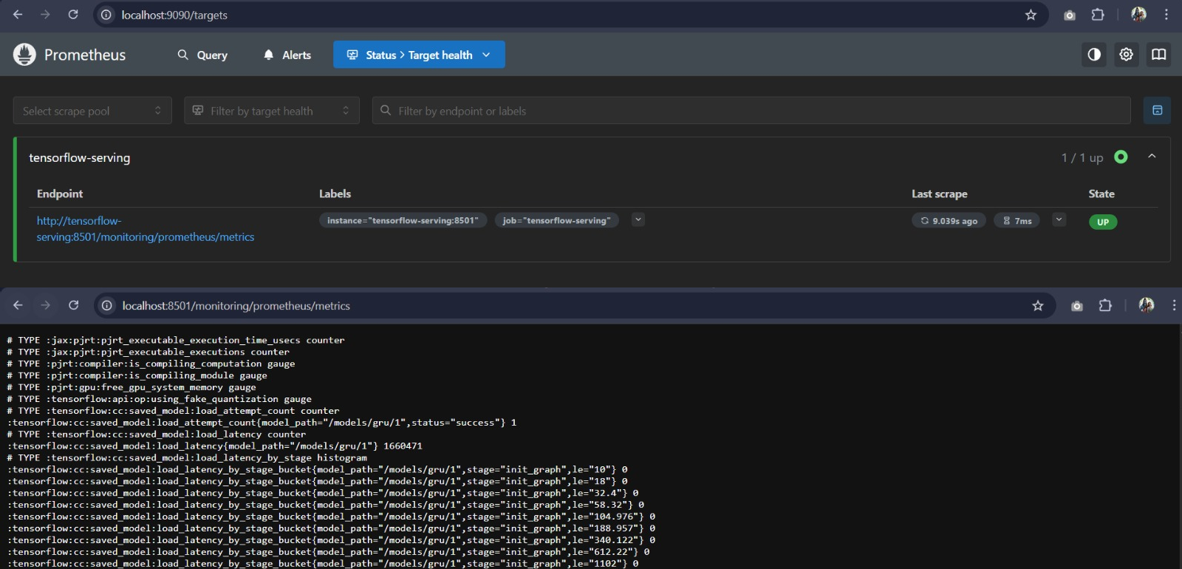
Stage 6 - Monitoring

Slide 35
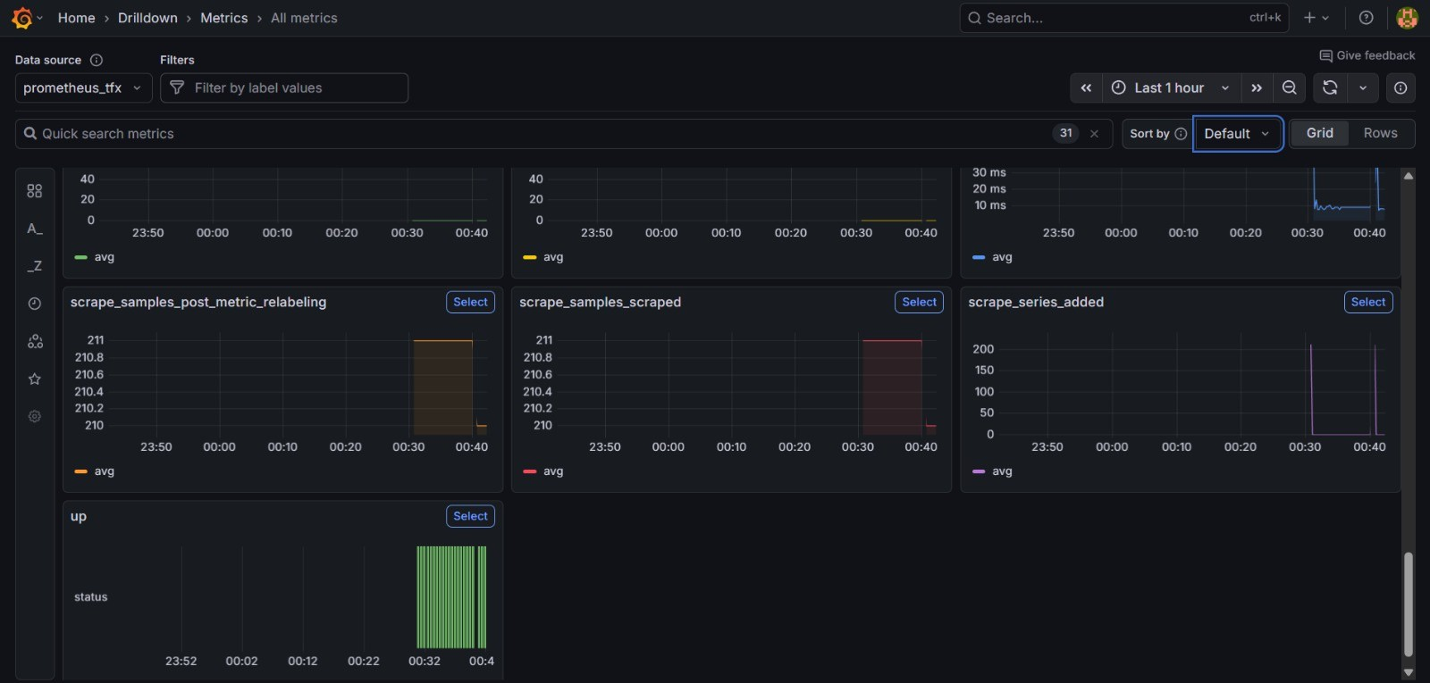
Stage 6 - Monitoring
Department of AI and ML

Slide 36

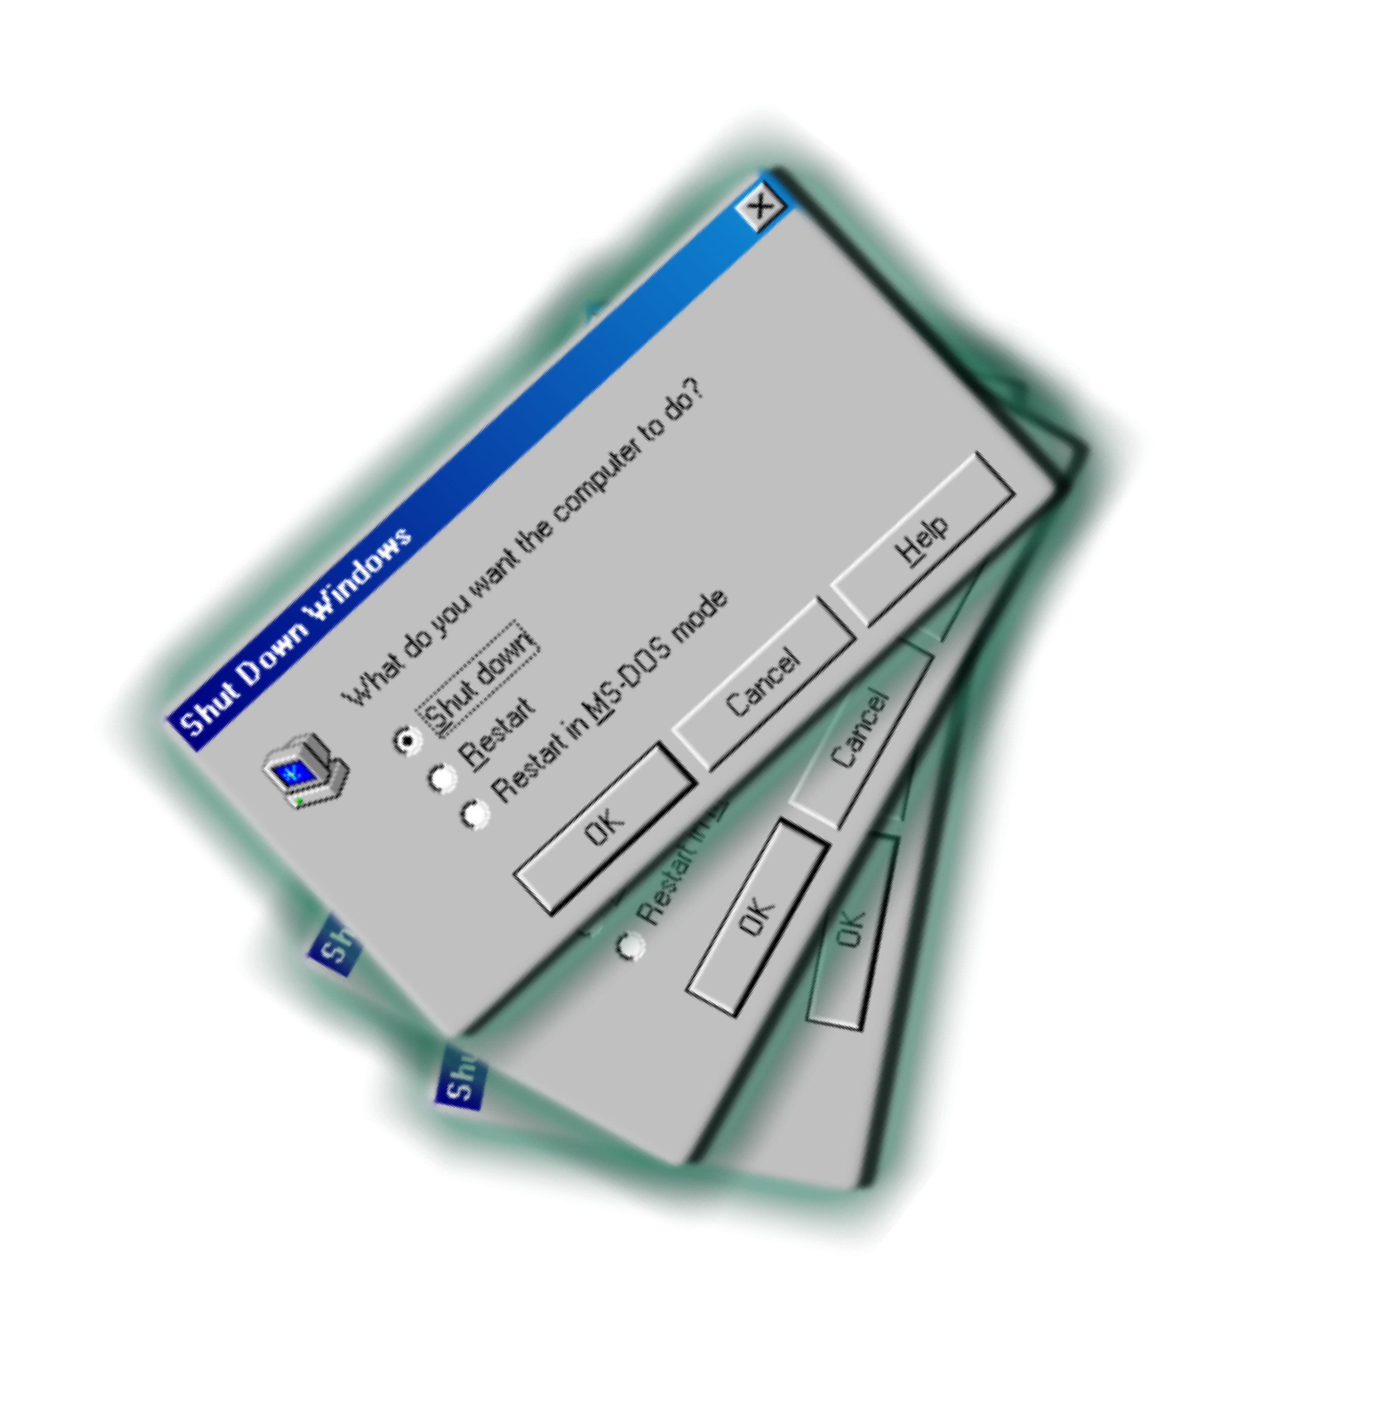
Stage 6 - Monitoring
Evidently AI
AI Fairness 360
SHAP and LIME
GardCAM++
Prometheus and Grafana
Datadog
Newrelic
Tensorflow Serving
Custom Websocket endpoints

Slide 37
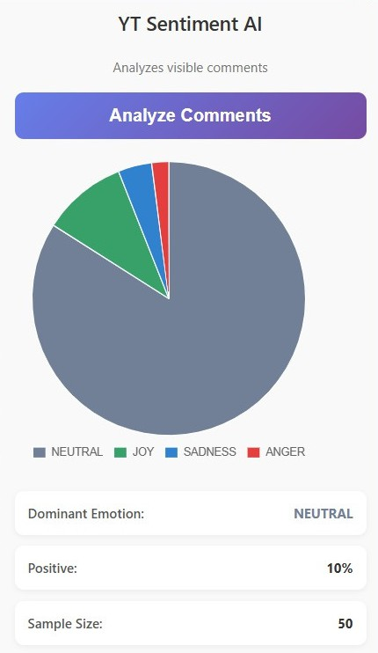
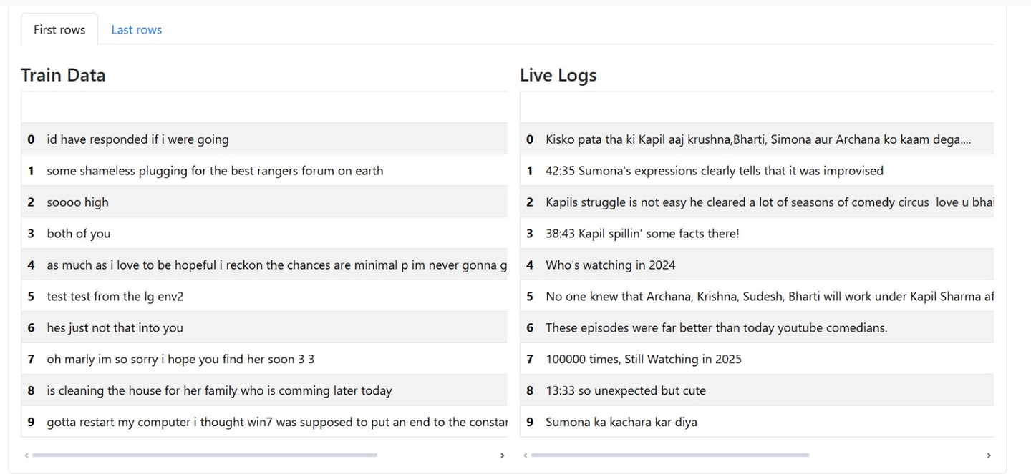
Stage 7- F^{G}ee^{o,}d^{c}b^{ha}a^{ng}c^{e}k^{the}L^{w}oºo^{rl}p^{d}
Post-Deploy Results
Department of AI and ML

Slide 38
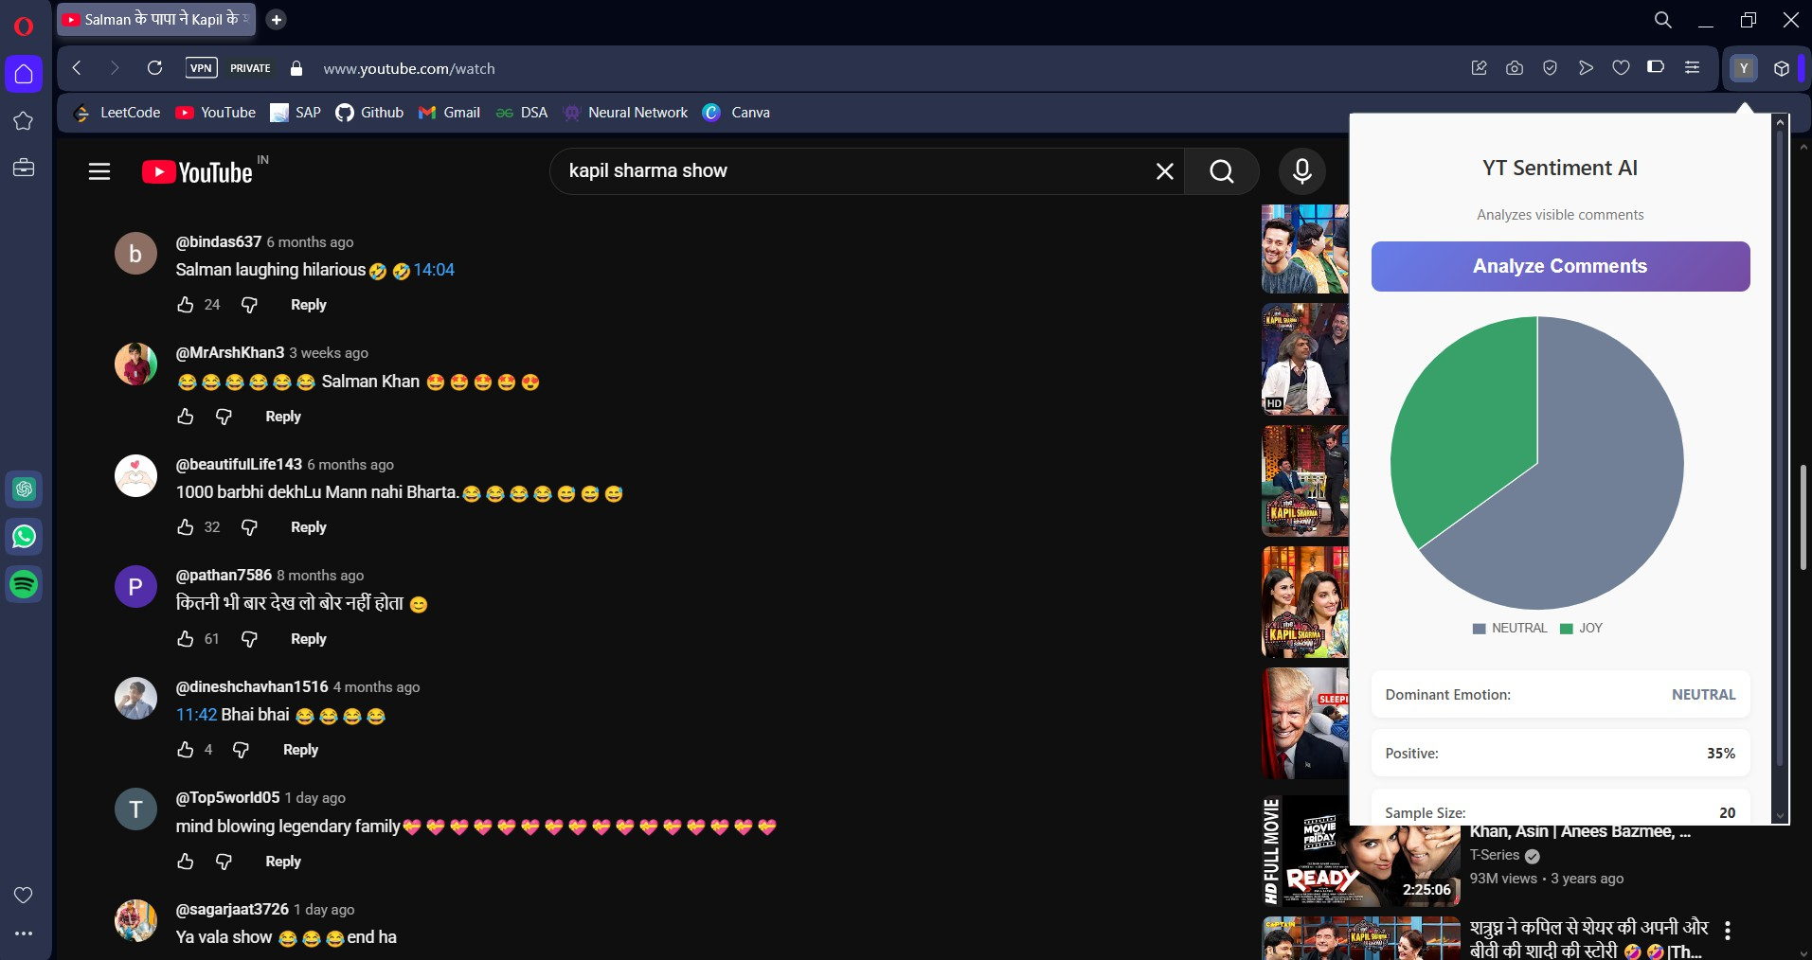
Stage 7- Feedback Loop
1.Github Actions
Department of AI and ML

Slide 39
SriRam’s Suggestions
Select Industry Standard Tools than the newer ones.
Check for version conflicts, especially with Tensorflow and Pytorch CPU Versions and GPU Versions
For sure check the VERSIONS !!! and maintain a proper Github Commit History
Learn how to merge different commits
Always, ALWAYS use Standard python libraries to make your code base cleaner – pydantic schemas, Pathlib file paths, Loguru (Logger), Rich for terminal printing
Select standard set of compatibles tools like the – Kubernates Family or MLFLow-Tensorflow Family
Learn to maintain proper directory structure, it is the key to any project (Look into Cookiecutter Templates if needed)
Always write your own documentation/journey.md / README.md file.
Try to run things offline rather than being dependent on some online hopeless people
Make sure to go step by step and make sure you dont push more than 100MB files in github, always maintain .gitignore and .dockerignore files
Focus more on learning the MLOPS tools in this subject rather than worrying about actual metrics of model

Slide 40

Department of AI and ML

